Slide 1
Requirements Acquisition
Tool
Team : 6
Members: Nabilahmed Patel
Shet Prajval
Tejaswini Mariyada
Limeng Shen
Wenbo Hu
Ashutosh Singh

Slide 2
Requirements
Constraints:
C.1 The RAT must be programmed in JAVA.
C.2 The RAT must be platform independent.
C.3 The RAT must use Stanford NLP to highlight verb and noun.
Requirements:
R.1 The RAT must provide a graphical user interface (GUI) to input the description and display the output.
R.1.1 The RAT must provide an input text-area for the user to input the description.
R.1.1.1 The user shall import description file into input text-area by clicking on “import” button.
R.1.1.2 The user shall enter description in input-text area manually by writing.
R.1.1.3 The user can edit the description in the input text-area.

Slide 3
Requirements
R.2 The RAT must have facility for user to identify Business Process, Steps and Actions.
R.2.1 User must be able to highlight verb-noun phrases manually.
R.2.2 User must be able to highlight verb-noun phrases automatically by clicking on “Highlight” Button.
R.2.3 User must be able to identify Business Process, Steps and Actions from highlighted verb-noun phrases.
R.2.4 RAT must have facility for user to provide other information related to business process in form of dialog box.
R.2.5 RAT shall display the identified business processes in the output text-area.

Slide 4
Requirements
R.3 User must be able to generate the requirements from identified business process.
R.3.1 RAT shall provide the “Generate” Button for user to click and generate the requirements.
R.3.2 RAT must generate the requirements from the information provided by the user and the identified business process.
R.4 RAT must provide output text-area to display the generated requirements.
R.4.1 RAT must display the generated requirements in the output text-area.

Slide 5
Requirements
R.5 RAT must provide the facility for user to edit the identified business process.
R.5.1 User must be able to edit and delete the identified business process.
R.5.2 RAT shall display the edited business process in the output text-area.
R.6 RAT shall provide the facility to export/save the generated requirements in the form of document.
R.6.1 RAT shall provide an “Save” button to export generated requirements into file.

Slide 6
Use Case Modelling
Abstract Use Cases:
UC1: Highlight Verb Noun Phrases(Actor: User, System : RAT)
UC2: Identify Business Processes, Steps and Actions(Actor: User, System: RAT)
UC3: Edit Business Processes, Steps and Actions(Actor: User, System: RAT)
UC4: Generate Requirements(Actor: User, System: RAT)
UC5: Export Requirements(Actor: User, System: RAT)

Slide 7
Use Case Modelling
High Level Use Cases:
UC1: Highlight Verb Noun Phrases
TUCBW The user clicks on the highlight button.
TUCEW The user views the highlighted verb noun phrases inside input textarea.
UC2: Identify Business Processes, Steps and Actions
TUCBW The user identifies business processes, steps and actions from highlighted verb noun phrases.
TUCEW The user sees the identified business processes, steps and actions inside outputarea.
UC3: Edit Business Processes, Steps and Actions
TUCBW The user clicks on the business process and edits it.
TUCEW The user sees the edited business process inside output area.

Slide 8
Use Case Modelling
High Level Use Cases:
UC4: Generate Requirements
TUCBW The user clicks on the generate button.
TUCEW The user views the generated requirements.
UC5: Export Requirements
TUCBW The user clicks on the save button.
TUCEW The user gets a saved file.

Slide 9
Use Case Modelling
Expanded Use Cases:
UC1: Highlight Verb Noun Phrases
Actor: User | System: RAT
 | 0.The RAT displays the description in the input-area
1. TUCBW the user clicks on the highlight button. | 2.The system highlight nouns to yellow color and verbs to red color in the input-area.
3.The user sees the highlighted description in the input-area.

Slide 10
Use Case Modelling
Expanded Use Cases:
UC2: Identify Business Processes, Steps and Actions
Actor: User | System: RAT
 | 0. System displays the GUI.
1. TUCBW user inputs the description. | 2. System shows the description in the input text-area.
3. User identifies highlighted verb noun phrases as business process, step or action. | 4. System pops-up the corresponding dialog-box.
5. User inputs the business process, steps, actions and priorities into the dialog-box. | 6. System stores business processes in list and displays in the output text-area.
7. TUCEW user sees the identified business processes.

Slide 11
Use Case Modelling
Expanded Use Cases:
UC3: Edit Business Processes, Steps and Actions
Actor: User | System: RAT
 | 0. The System displays the identified business processes in the output text-area.
1. TUCBW user right clicks on the identified business process. | 2. The system pops-up menu.
3. The user selects the edit or delete option from the menu. | 4. The system pops-up the dialog-box for corresponding business process.
5. The user repeatedly edits business processes of output text-area. | 6. System makes relevant changes into the list and output text-area.
7. TUCEW the user sees business process is successfully edited.

Slide 12
Use Case Modelling
Expanded Use Cases:
UC4: Generate Requirements
Actor: User | System: RAT
 | 0.The RAT displays the identified business processes in to the output textarea.
1. TUCBW the user clicks on the generate button. | 2.The system generates requirements from the identified business processes and displays them into output textarea.
3.The user shows the generated requirements in output textarea.

Slide 13
Use Case Modelling
Expanded Use Cases:
UC5: Export Requirements
Actor: User | System: RAT
 | 0.The RAT displays the generated requirements in to the output text-area.
1. TUCBW the user clicks on the export button. | 2.The system displays the dialog-box for user to edit the file location and file name.
3.The user clicks on the save as txt button or save as xml button. | 4. The system displays the requirements was successfully saved.
5. The user gets a saved file.

Slide 14
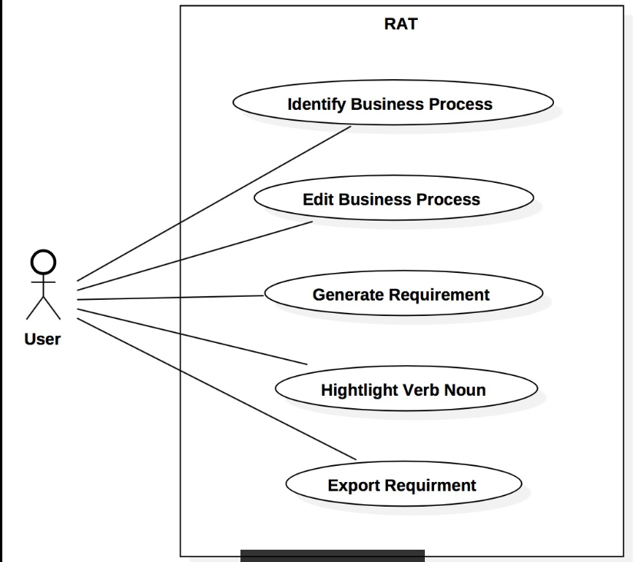
Use Case Modelling

Slide 15
Use Case Modelling
Requirement-UseCase Tracibility Matrix:
Requirement | Priority | UC1 | UC2 | UC3 | UC4
R01
R02 | 1 | X
R03 | 2 |  | X
R04
R05 | 3 |  |  | X
R06 | 4 |  |  |  | X
UC PRIORITY |  | 1 | 2 | 3 | 4

Slide 16
Domain Modelling
Brainstorming:
Domain Information of Requirement Acquisition
A user is given³ the textual⁴ description¹. A user¹ is able to edit³ the description. The verb-noun phrases¹ are identified³ by the user manually or by the system automatically using NLP from the given description. The identified verb-noun phrases are categorized³ into business processes¹, steps¹ and actions¹. The business process consists of steps⁷,and the step consists of actions⁷.The requirements¹ are generated³ from categorized business processes , steps and actions . The generated requirements are in an ordered⁴ format¹. The requirements are saved³ by the user.

Slide 17
Domain Modelling
Classification:
Brainstorming List | Classification Result | Rule
description¹ | (C) Description | 1(a)
requirement¹ | (C) Requirement | 1(a)
given³ | (AS) given ( user, description) | 3
textual⁴ | (V) textual | 4
user¹ | (C) User | 1(a)
edit³ | (AS) edit (user, description) | 3
identify³ | (AS) identify (user, verb-noun phrase) | 3
verb-noun phrase¹ | (C) Verb-Noun Phrase | 1(a)
business processe¹ | (C) Business Process | 1(a)
step¹ | (C) Step | 1(a)

Slide 18
Domain Modelling
Classification:
Brainstorming List | Classification Result | Rule
action¹ | (C) Action | 1(a)
generated³ | (AS) generated (business processes, requirements) | 3
generated³ | (AS) generated (steps, requirements) | 3
generated³ | (AS) generated (actions, requirements) | 3
process consists of⁷ | (AG) consists of (business process, steps) | 7
steps consists of⁷ | (AG)consists of (steps, actions) | 7
ordered⁴ | (V) ordered | 4
format¹ | (A) format | 1(e)
save³ | (AS) save (user, requirements) | 3

Slide 19
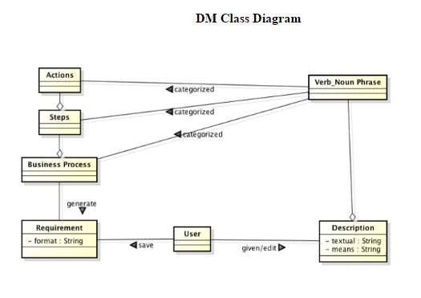
Domain Modelling

Slide 20
Object Interaction Modelling
Scenario
UC1: Highlight Verb Noun Phrases
1. 2.1 2.2 2.3 2.3 2.5 2.6 2.7 | The user clicks the highlight button. The GUI send description text to HighlightController. The HighlightController passes description to NLParser. The NLParser parses the description. The NLPaser send taged verbs-nouns to HighlightController. The HighlightController send the taged nouns to GUI. The GUI set nouns to yellow color and verbs to red color. The GUI shows the highlight description.

Slide 21
Object Interaction Modelling
ScenarioTable:
Subject | Subject action | Other data/Objects | Object Acted Upon | Subject
User | clicks | highlight button | GUI | User
GUI | send | description | HighlightController | GUI
HighlightController | passes | description | NLParser | HighlightController
NLParser | send | taged verbs-nouns | GUI | NLParser
GUI | set | color | verbs-nouns | GUI
GUI | shows | highlight description |  | GUI

Slide 22
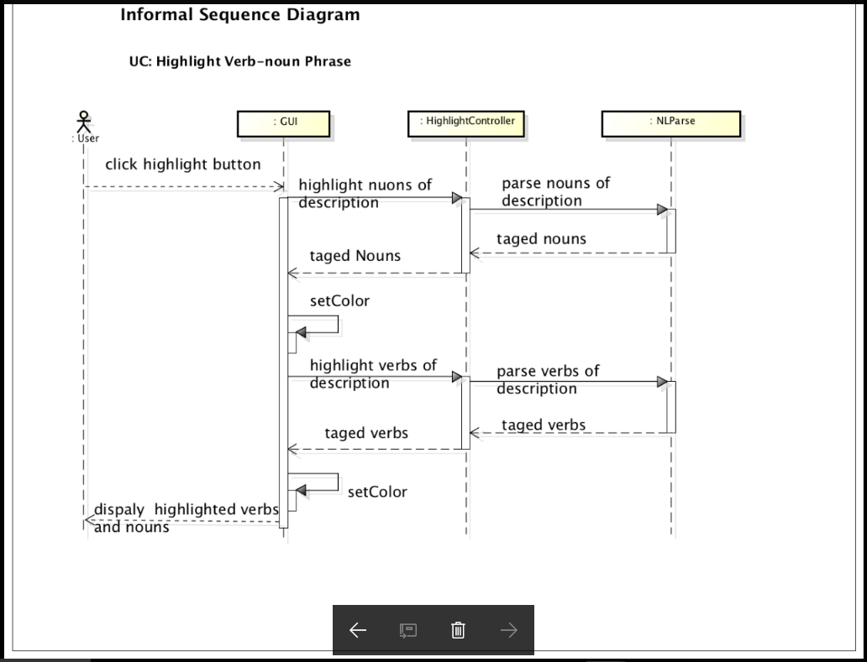

Slide 23
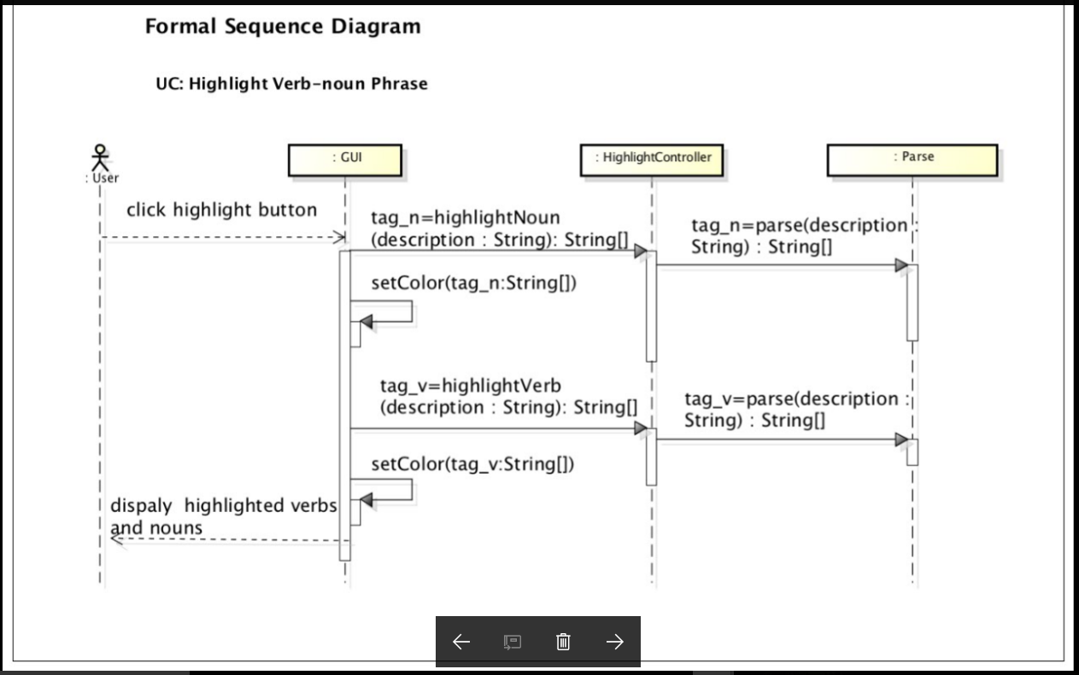

Slide 24
Object Interaction Modelling
Scenario
UC2: Identify Business Process, Steps and Actions
5. 6. 6.1 6.1.1 6.1.2 6.1.2.1 6.1.2.2 6.1.3 6.1.4 6.1.5 6.2 | User inputs the business processes, steps, actions and priorities from the dialog-box. The GUI sends the business processes and the parameters including steps, actions, priorities to BPController. For each business process, The BPController creates BusinessProcess object using business process. For each parameter, BPController creates the Object or attribute of corresponding Parameter. BPController adds parameter Object or attribute into BusinessProcess Object. The BPController sends the BusinessProcess object to StoreMgr. The StoreMgr saves the BusinessProcess object in List. The BPController sends the BusinessProcess object in string format to the GUI. GUI displays the business processes in the output text-area.

Slide 25
Object Interaction Modelling
ScenarioTable:
# | Subject | Subject action | Other data/Objects | Object Acted Upon
5. | User | inputs | business processes,steps,actions and priorities | GUI
6 | GUI | sends | business processes and parameters | BPController
6.1 | For each business process
6.1.1 | BPController | creates | busineess process | Business process object
6.1.3 | For each parameter
6.1.3.1 | BPController | creates | parameter | Object or attribute
6.1.3.2 | BPController | adds | Object or attribute | BusinessProcess Object
6.1.4 | BPController | sends | Business Process Object | StoreMgr
6.1.5 | StoreMgr | saves | Business Process Object | List
6.1.6 | BPController | sends | Business Process Object | GUI
6.2 | GUI | displays | business process | output text-area

Slide 26
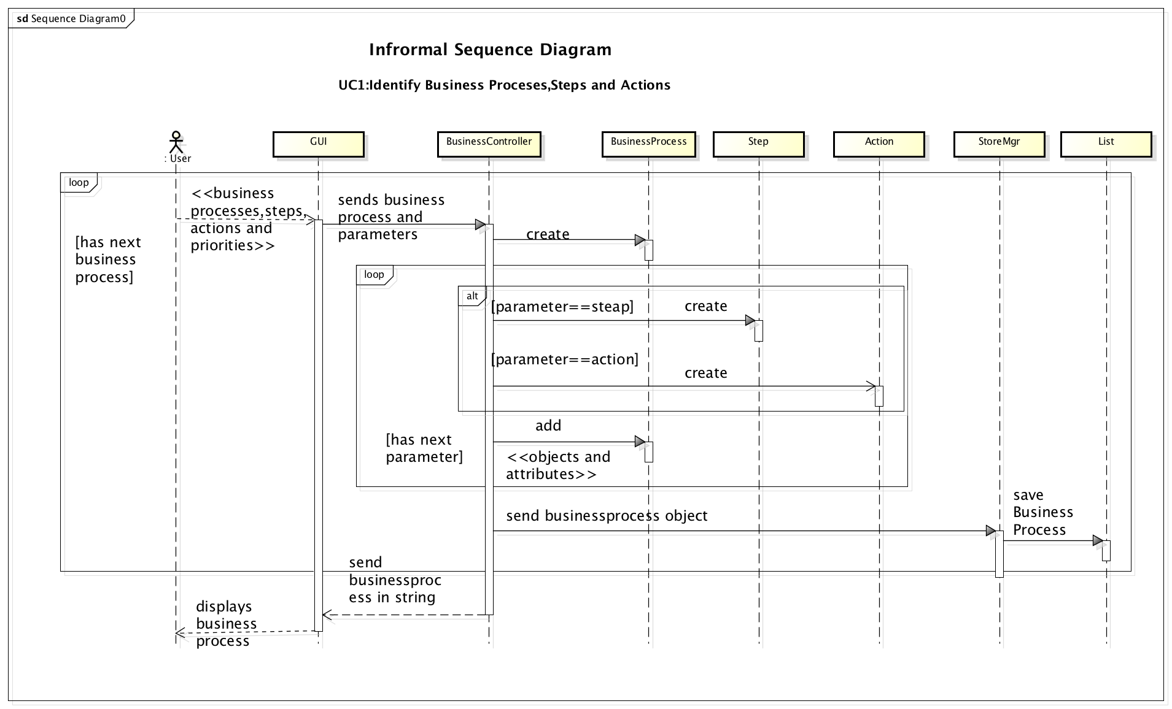

Slide 27
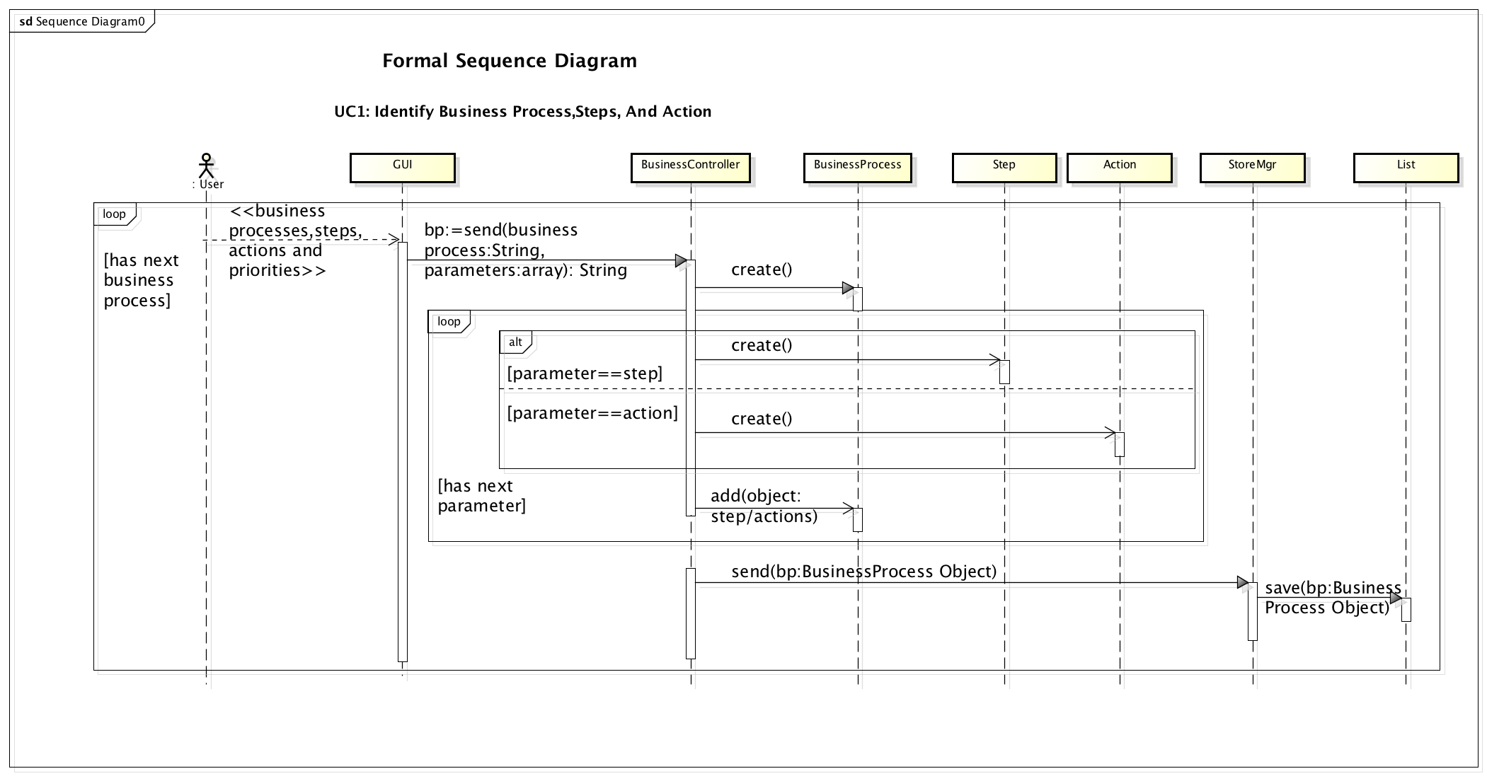

Slide 28
Object Interaction Modelling
Scenario
UC3: Edit Business Processes
3. 4.1 4.2 4.2.1 4.2.2 4.2.2.1 4.2.3 4.2.3.1 4.2.3.2 4.2.3.1.1 4.2.3.1.2 4.2.3.3 4.2.3.4 4.2.3.5 4.3 | The User edits the business processes of output text-area. The GUI sends the business processes and the parameters including steps, actions, priorities to the BPController. For each business process, The BPController sends the business process and action to StoreMgr. If action is delete, StoreMgr removes BusinessProcess object for business process. If action is edit, StoreMgr sends BusinessProcess object for business process to BPController. For each parameter, BPController edits the Object or attribute of corresponding Parameter BPController edits parameter Object or attribute into BusinessProcess Object. The BPController sends the BusinessProcess object to StoreMgr. The StoreMgr saves the BusinessProcess object in List. The BPController sends the BusinessProcess object in string format to the GUI. GUI displays the edited business processes in the output text-area.

Slide 29
Object Interaction Modelling
ScenarioTable:
# | Subject | Subject action | Other data/Objects | Object Acted Upon
4. | User | edits | output text-area | Business processes
4.1 | GUI | sends | business processes and parameters | BPController
4.2 | For each business process
4.2.1 | BPController | sends | Business processes, action | StoreMgr
4.2.2 | If the action is delete
4.2.2.1 | StoreMgr | removes | Business Process object | List
4.2.3 | If the action is a edit
4.2.3.1 | StoreMgr | sends | Business Process object | BPController
4.2.3.2 | For each parameter
4.2.3.2.1 | BPController | edits | parameter | Object or attribute
4.2.3.2.2 | BPController | edits | Object or attribute | BusinessProcess Object

Slide 30
Object Interaction Modelling
ScenarioTable (Cont.)
# | Subject | Subject action | Other data/Objects | Object Acted Upon
4.2.3.2 | BPController | sends | Business Process Object | StoreMgr
4.2.3.4 | StoreMgr | saves | Business Process Object | List
4.2.3.5 | BPController | sends | Business Process Object | GUI
4.3 | GUI | displays | business process | output text-area

Slide 31
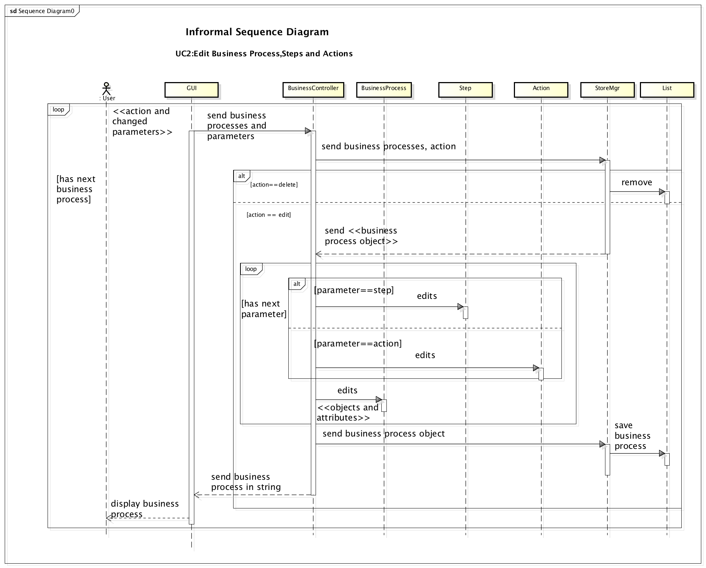

Slide 32
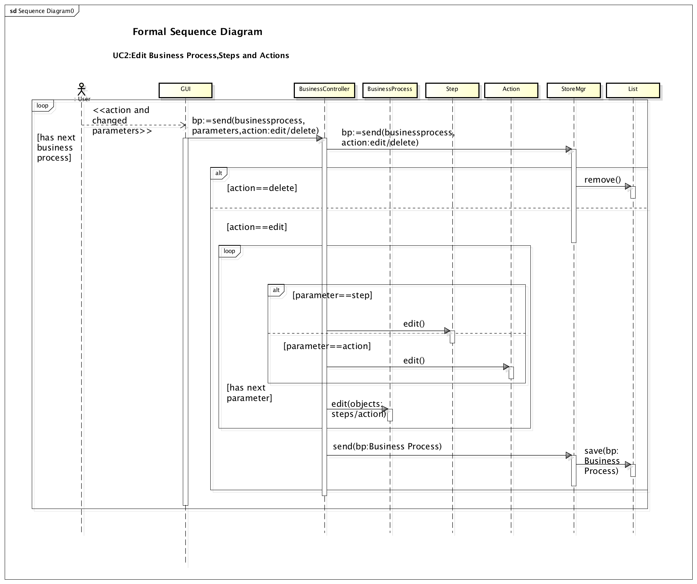
Object Interaction Modelling

Slide 33
Object Interaction Modelling
Scenario
UC4: Generate Requirements
2 3 3.1 3.2 3.3 3.4 3.5 3.6 | The user clicks the generate button. For each business process, The RATController fetches business process object from StoreMgr for business process. The RATController passes fetched business process object to parser. The Parser parses business process object and generates the requirement. The Parser sends back generated requirements to RATController. The RATController sends requirements to the GUI. The GUI shows the generated requirements.

Slide 34
Object Interaction Modelling
ScenarioTable:
# | Subject | Subject action | Other data/Objects | Object Acted Upon
2. | User | clicks | generate button | GUI
3 | For each business process
3.1 | RATController | fetches | fetched business process object | StoreMgr
3.2 | RATController | passes | Business Process object | Parser
3.3 | Parser | parses | requirements | Business process object
3.4 | Parser | sends | generated requirements | RATController
3.5 | RATController | sends | requirements | GUI
3.6 | GUI | shows | generated requirements | User

Slide 35
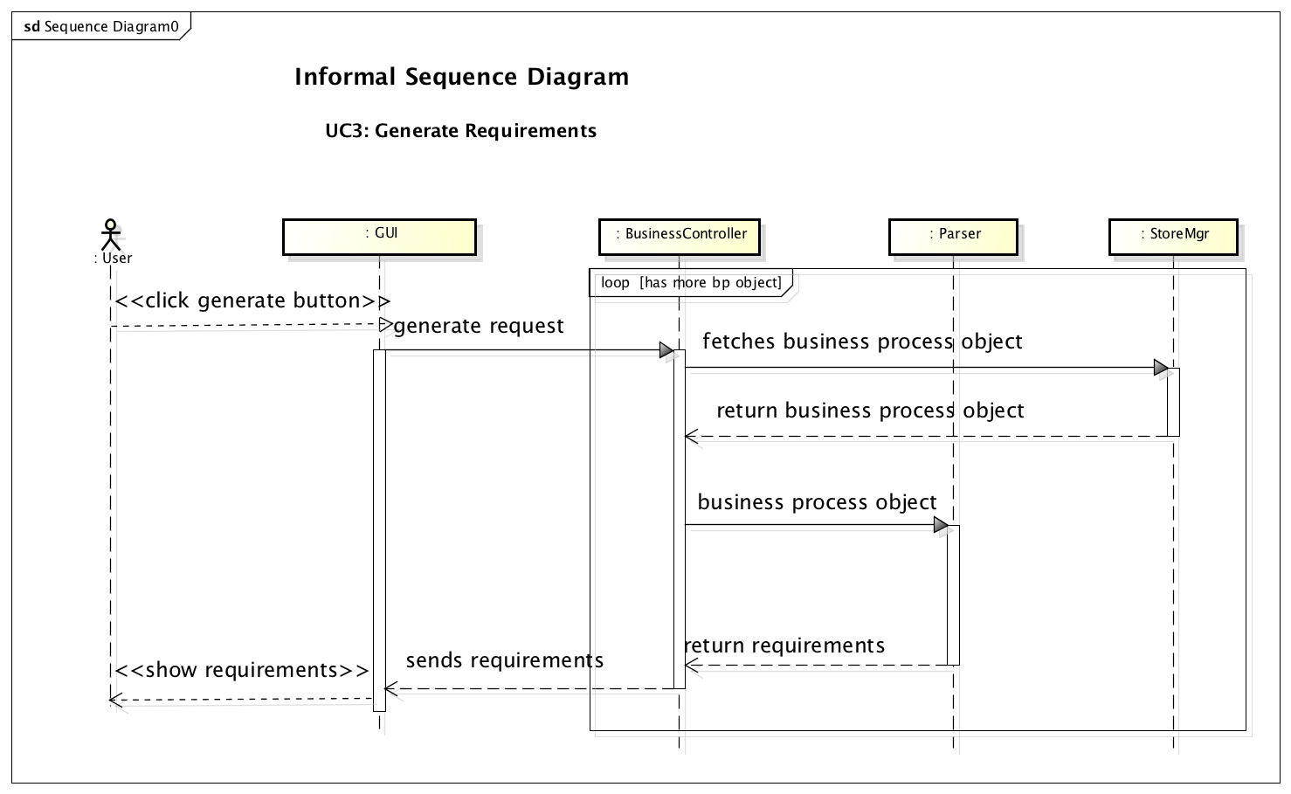

Slide 36
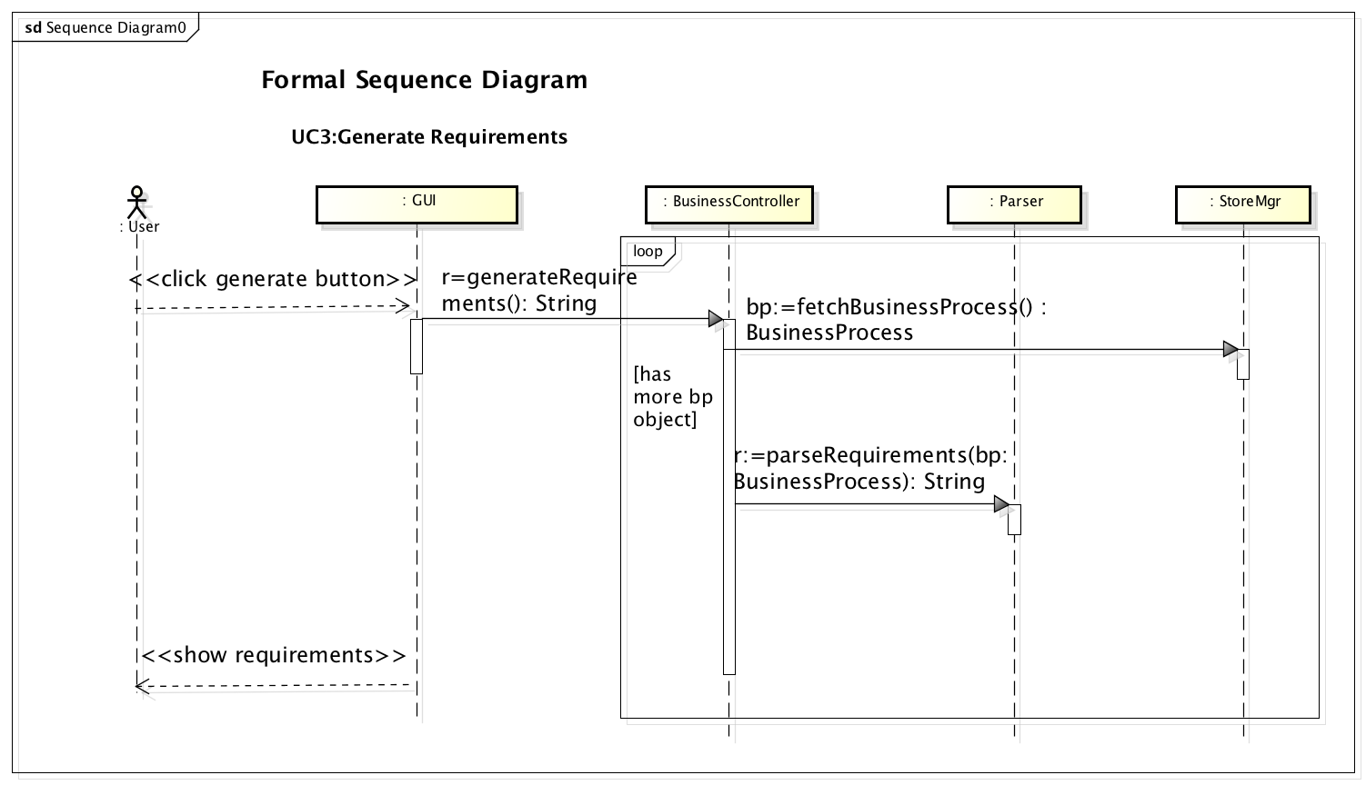

Slide 37
Object Interaction Modelling
Scenario
UC5: Export Requirements
3. 4.1 4.1.1 4.1.2 4.1.3 4.2 4.2.1 4.2.2 4.2.3 | The user clicks on the save as txt button or save as xml button. If user click txt-button, The ExportController creates SaveAsTxt object. SaveAsTxt object get requirements from Context object. SaveAsTxt object save requirements to file. If user click on xml-button The ExportController creates SaveAsXML object. SaveAsXML object get requirements from Context object. SaveAsXML object save requirements to file.

Slide 38
Object Interaction Modelling
ScenarioTable:
# | Subject | Subject action | Other data/Objects | Object Acted Upon
3. | User | enters | File name | GUI
4.1 | If user click txt-button
4.1.1 | ExportController | creates |  | SaveAsTxt object
4.1.2 | SaveAsTxt object | get | requirements | GUI
4.1.3 | SaveAsTxt object | save | requirements | File
4.2 | If user click xml-button
4.2.1 | ExportController | creates |  | SaveAsXml Object
4.2.2 | SaveAsXml Object | get | requirements | GUI
4.3.3 | SaveAsXml Object | save | requirements | File

Slide 39
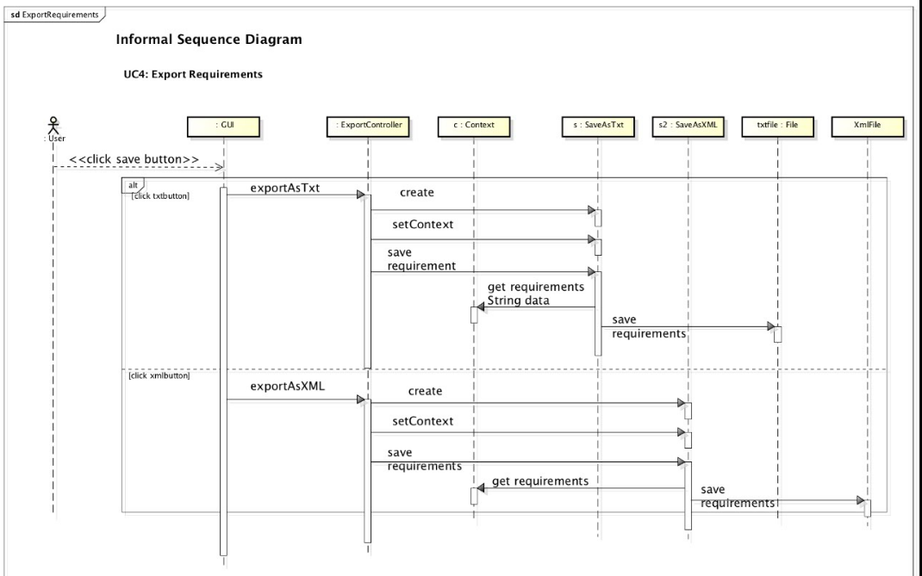

Slide 40
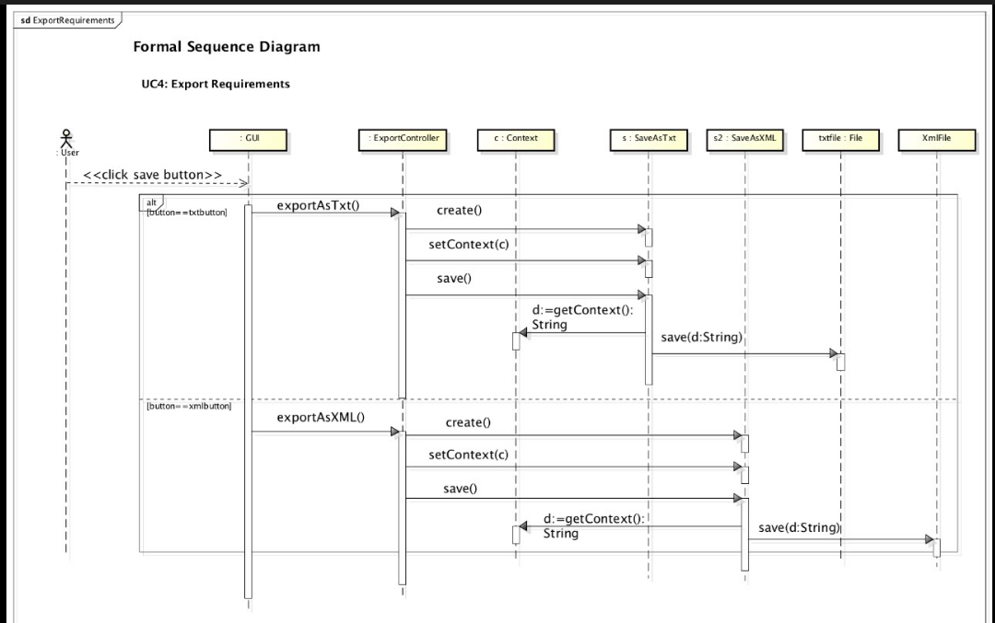

Slide 41
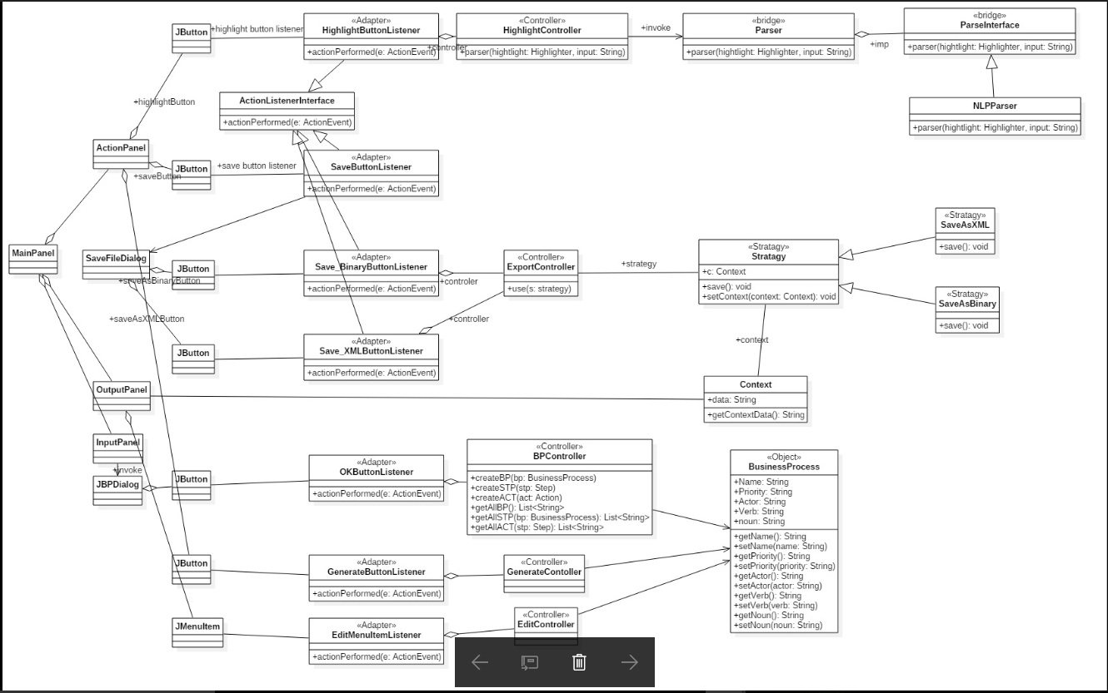
Design Class Diagram

Slide 42
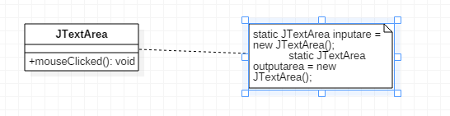
Applying Patterns
Singleton Pattern:
Problem: Input and output textarea are unique and need not to be initialized every time.
Solution: Input and output textarea has to be static as it is only defined single time.
All the GUI Components are static.

Slide 43
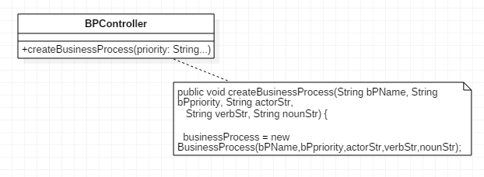
Applying Patterns
Creator Pattern:
Problem: Object Of BusinessProcess, Step and Action should be created from some entity.
Solution: BPController Class is creating objects for BusinessProcess, BusinessProcess is creating object for Step and Step is creating object for Action.

Slide 44
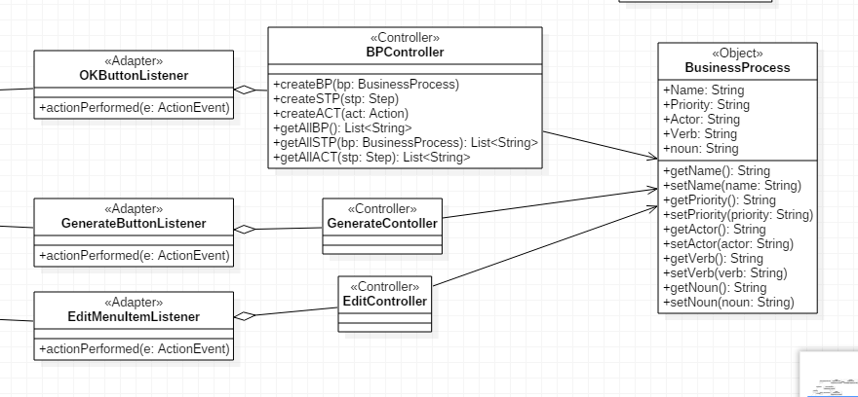
Applying Patterns
Controller Pattern:
Problem: Creating, editing business process, generating and exporrting requiements are requests to GUI. This requests should be handled separately.
Solution: Creating controller class for each use case is taking care of handling request of GUI.

Slide 45
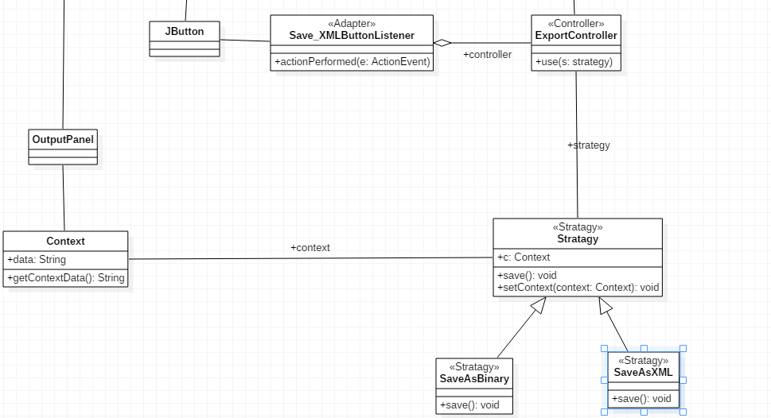
Applying Patterns
Stratagy Pattern:
Problem: User can export the requirements in different formats.
Solution: Definign abstract class Stratagy as a common interface.

Slide 46
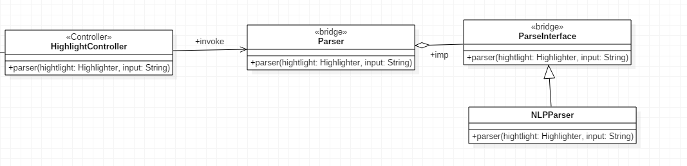
Applying Patterns
Bridge Pattern:
Problem: Right now system uses NLP Parser to find verb noun in future there might be different Parser.
Solution: Provide ParserInterface so it can decouple the implementation from client interface.

Slide 47
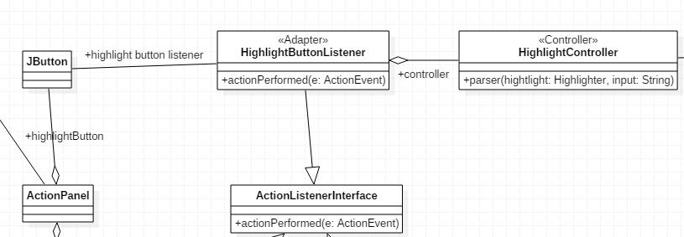
Applying Patterns
Adapter Pattern:
Problem: To provide the javas inbuilt functionalities, we will have to convert one interface to another.
Solution: ButtonListener and Mouse Listener implement ActionListener interfaceclient interface and MouseListener interface respectively.

Slide 48
THANK YOU

